Slide 1
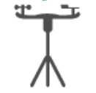

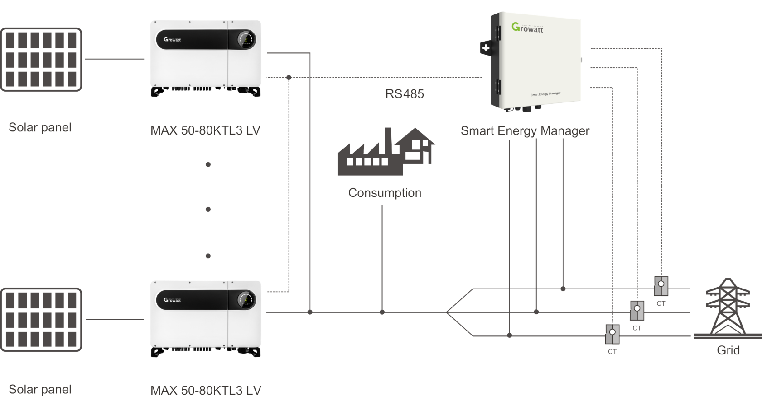
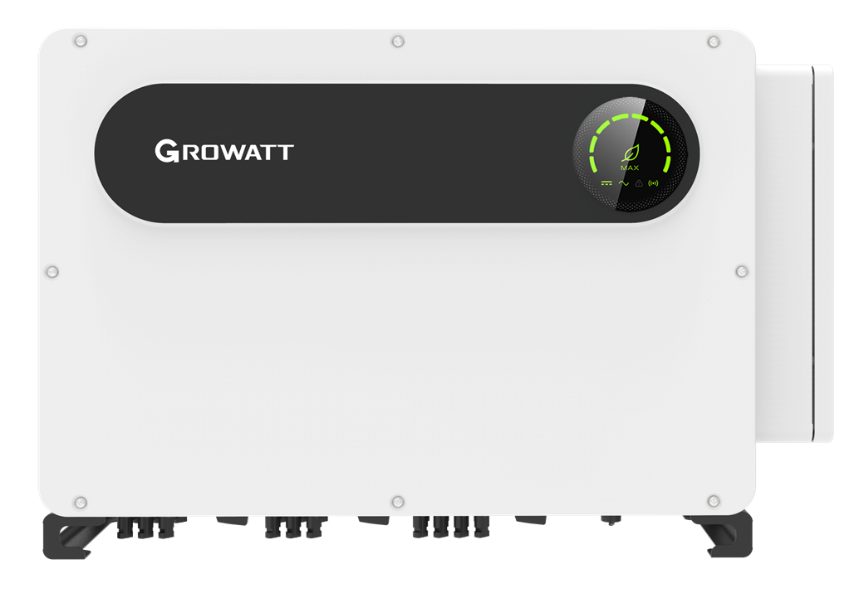
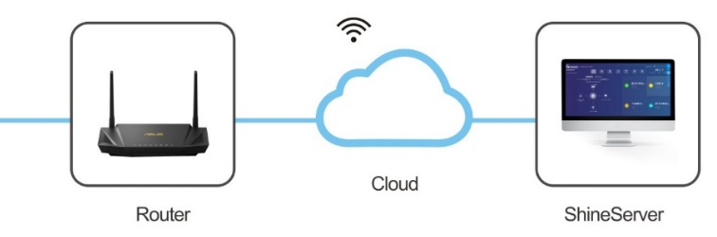
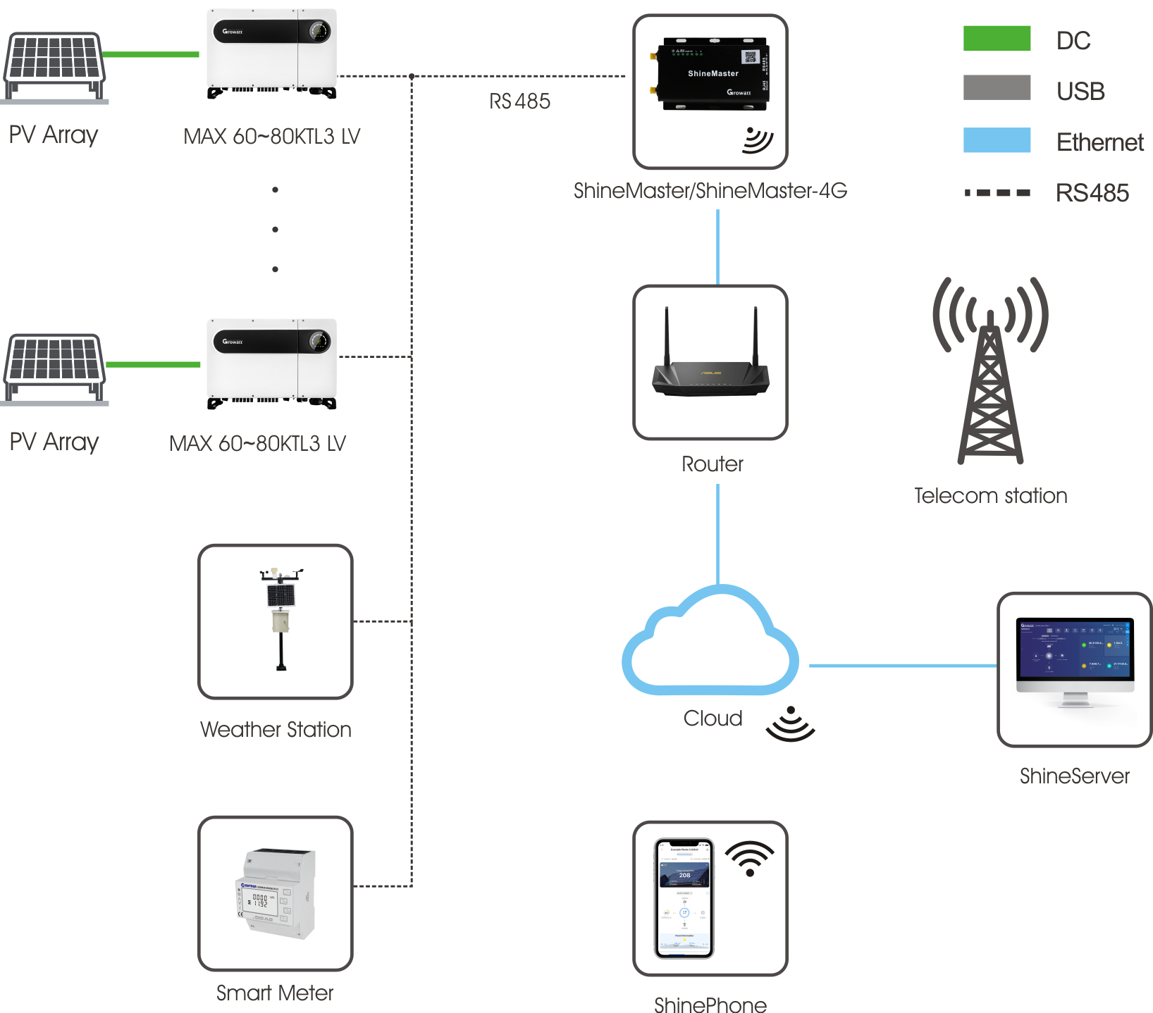
System Diagram
Weather Station
SCADA Systems
RS485
RJ45
RJ45 (Modbus TCP)
MAX 100-125KTL3-X LV
AC
MAX 100-125KTL3-X LV
1. Weather station need connect to ShineMaster RS485-2, together with meter communication
2. RS 4852 is for inverter connection

Slide 2
Communication and control
1. Third Party platform communicate through Modbus TCP to communictae with ShineMaster as below according Growatt inverter Modbus RTU protocol, Shinmaster work as slave, third party work as master.
Data read
Third party read inverter register (03, 04 command)
ShineMaster send the inverter data when get the command
Command interval time need more than 5s
Data write
Third party write inverter register (06 command)
ShineMaster send the setting to inverter real time, and feedback the result
command Interval time more than 5s
Inverter
Please refer to Growatt Modbus RTU protocol P7-10 to understand how to get and write inverter data, and register map.

